Slide 1
Automated Stock Management in Packaging Industry
Jeet Doshi-A037
Kush Gupta-A061
Kabir Faridi-A065
Faculty Mentor: Mrs. Swati Donde

Slide 2
INTRODUCTION

Slide 3
LITERATURE REVIEW

Slide 4
RESEARCH GAP

Slide 5
PROBLEM STATEMENT

Slide 6
OBJECTIVES

Slide 7
RESEARCH METHODOLOGY
DEVELOPMENT OF APP

Slide 8
Problem Statement
Managing and tracking packaging materials in warehouses is still mostly manual, leading to misplaced items, delays, and inaccurate stock levels. There is a need for an automated system that uses sensors and a digital app to track goods in real time and place them accurately in their required locations.

Slide 9
Proposed Solution
Our proposed solution is an app-based automated inventory management system for the packaging industry. It uses sensors to detect stock levels and product positions, helping in accurate placement of goods within the warehouse. The system updates data in real time, reducing manual effort, errors, and improving overall efficiency.

Slide 10
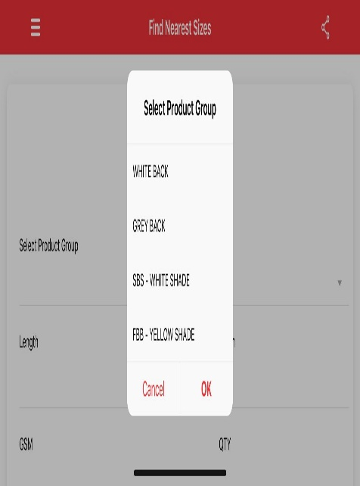
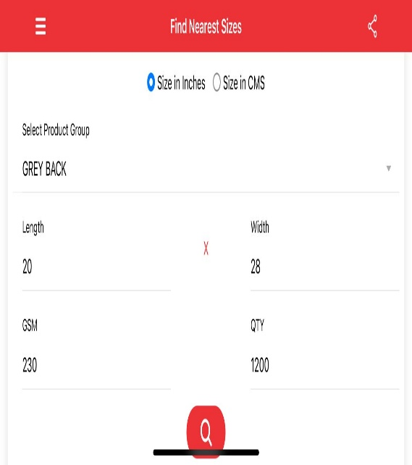
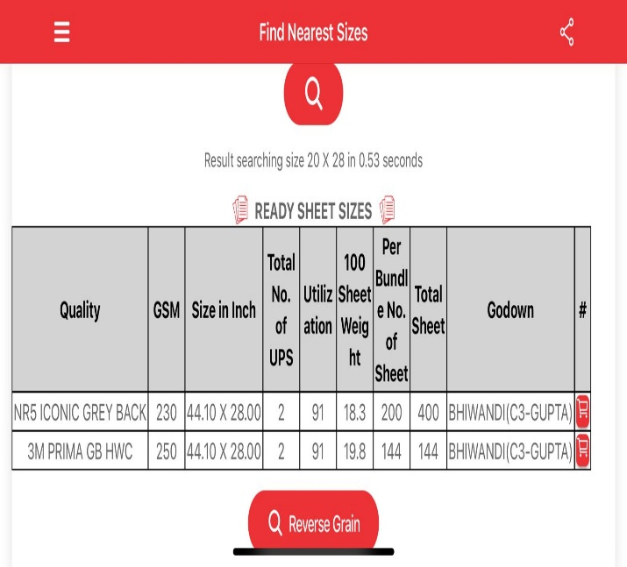
App Working and Design

Slide 11
Smart Packaging
Smart packaging integrates digital identification and sensing technologies such as RFID, NFC, and QR codes into packaging materials. These smart systems allow each package to act as a digital data node, reporting its location, condition, and quantity in real time. This helps in maintaining full visibility across the supply chain while reducing human dependency for stock checks.
Key Points:
1.Converts packaging into intelligent units capable of data communication.
2.Enables real-time traceability from production to delivery.
3.Condition monitoring sensors detect temperature, pressure, or freshness.
4.Reduces waste by ensuring optimal storage and handling.
5.Supports predictive logistics through data analytics.

Slide 12
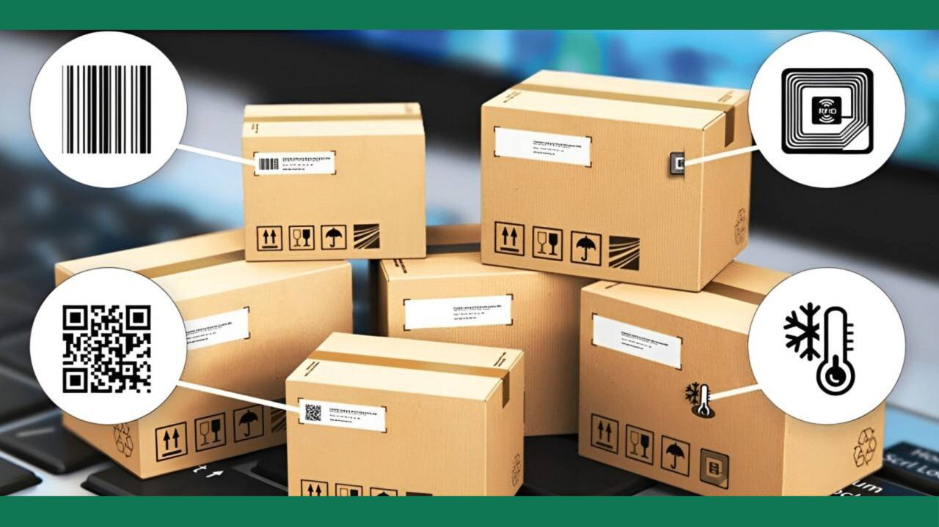
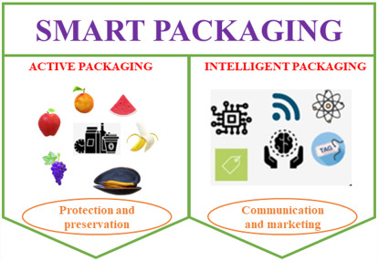

Slide 13
RFID Technology in Packaging
RFID (Radio Frequency Identification) is widely used for automated tracking in warehouses. It allows bulk scanning without manual effort and improves stock accuracy significantly. Companies like Walmart, Zara, and Grupo Boticário implemented RFID to speed up audits and minimize stockouts.
Key Points:
1.Enables non-line-of-sight scanning of multiple items.
2.Reduces counting time by up to 90%.
3.Improved inventory accuracy from 85% → 98–99%.
4.Effective for cartons, pallets, and reusable packaging.

Slide 14
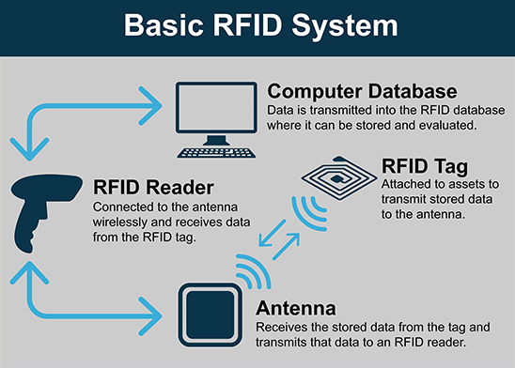
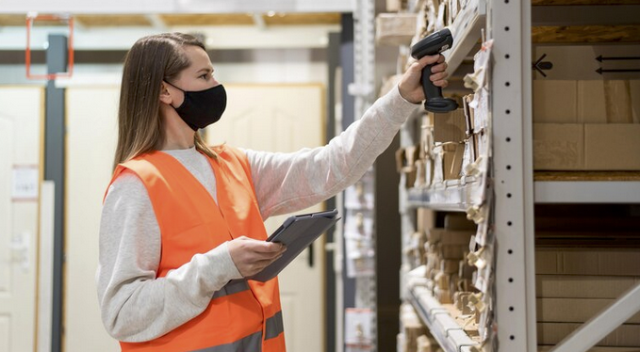

Slide 15
IoT and Smart Sensors
The Internet of Things (IoT) and smart sensors play a crucial role in automating stock monitoring in the packaging industry. These sensors collect real-time data on stock levels, environmental conditions, and product movement. The integration of IoT ensures that data from various sensors—such as weight, ultrasonic, and vision systems—is continuously transmitted to a centralized dashboard for accurate tracking and automated replenishment.
Key Points:
1.Weight sensors: Detect load and estimate quantity of rolls, films, or packaging sheets.
2.Ultrasonic sensors: Measure the fill levels of bins or silos, triggering alerts when stock is low.
3.Vision systems: Use cameras to count, identify, and verify packaged goods.
4.Environmental sensors: Monitor temperature and humidity for sensitive products like food or pharmaceuticals.
5.Hybrid sensor systems (RFID + vision + weight) offer the best accuracy and reliability.

Slide 16
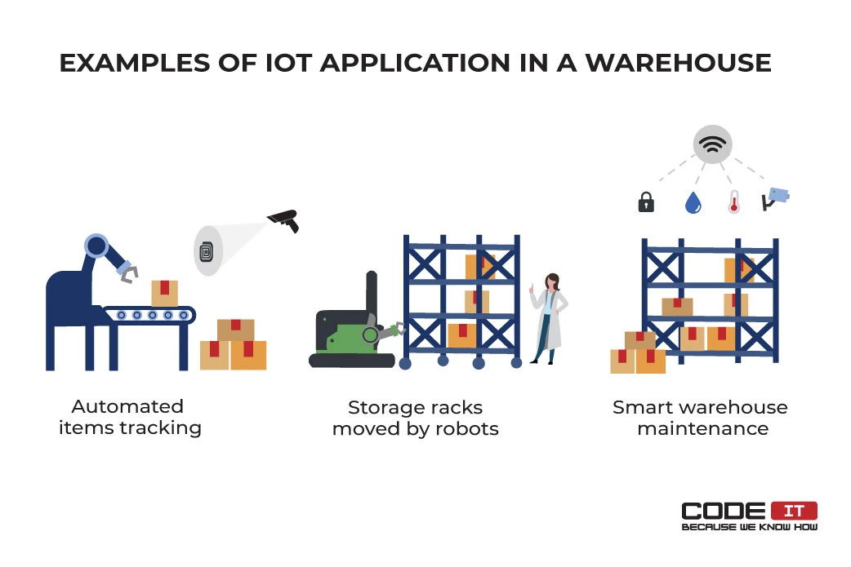
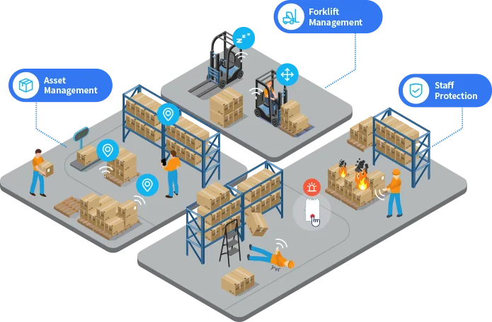

Slide 17
ERP/WMS Integration
Automation becomes truly effective when inventory data from sensors and RFID systems is integrated with ERP (Enterprise Resource Planning) and WMS (Warehouse Management Systems) platforms. This integration allows automatic stock updates, reorder generation, and workflow optimization, ensuring data consistency between physical operations and business management systems.
Key Points:
1 .Real-time synchronization: Inventory data auto-updates in ERP/WMS software.
2.Automated reordering: System triggers restock alerts when thresholds are reached.
3.Improved accuracy: Reduces manual entry errors and reporting delays.
4.Vendor-Managed Inventory (VMI): Enables suppliers to monitor customer stock remotely.
5.Better decision-making: Managers can track stock, costs, and trends from one dashboard.

Slide 18
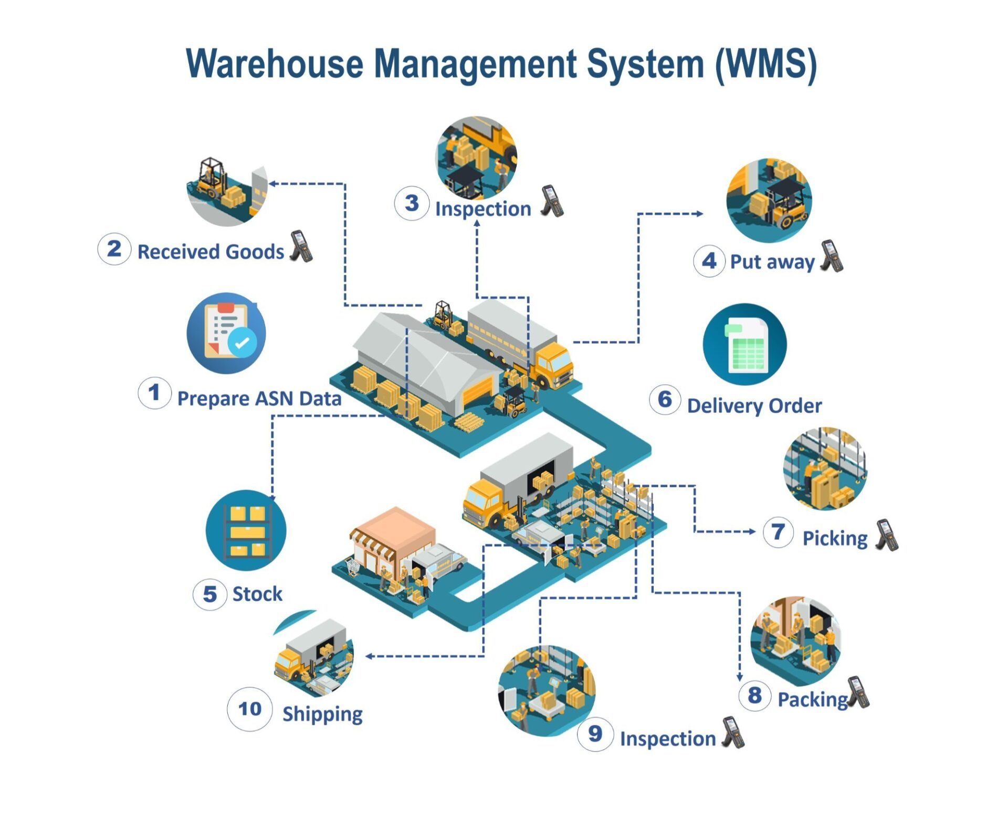
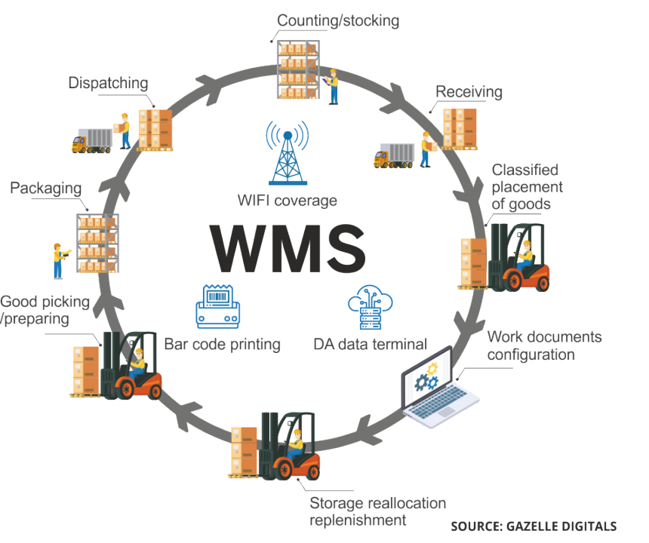

Slide 19
Research Gaps / Limitations of Existing Systems
Even though many technologies like RFID, IoT, and ERP systems are used, some problems still exist. These systems are often costly, not fully connected with each other, and depend too much on the internet. Small packaging companies find them hard to use or maintain.
Main Points:
1.Lack of one complete system combining all technologies.
2.Cloud-based systems cause delay and need strong internet.
3.High cost makes it hard for small industries to adopt.
4.Data security and privacy are still a concern.
5.No low-cost local solution available for small packaging units.

Slide 20
Objectives
Examine how sensors (RFID, weight, ultrasonic, vision, and environmental) improve inventory management in the packaging industry.
Identify key performance metrics (accuracy, cycle-count time, ROI) from existing studies.

Slide 21
Conclusion
We explored various technologies like RFID, IoT sensors, and ERP systems used in the packaging industry for stock management. While these improve accuracy, they are often costly or complex. Our app-based model combines automation and simplicity — using sensors for real-time tracking and product placement, making warehouse management faster, more accurate, and affordable for all packaging units.

Slide 22
Thank You!

